Slide 1

Introduction to UML
Slide Set - 7
Organized & Presented By:
Software Engineering Team, CSED
TIET, Patiala

Slide 2
Overview
What is Modeling?
What is UML?
Why UML?
Understanding the basics of UML
UML diagrams
UML Modeling tools

Slide 3
Modeling
Models are abstractions that portray the essentials of a complex problem or structure by filtering out nonessential details.
Describing a system at a high level of abstraction
  A model of the system
  Used for requirements and specifications
Models help us organize, visualize, understand, and create complex things.
Is it necessary to model software systems?

Slide 4
What is UML?
UML stands for “Unified Modeling Language”
It is an industry-standard graphical language for specifying, visualizing, constructing, and documenting the artifacts of an object-oriented system under development.
The UML uses mostly graphical notations to express the OO analysis and design of software projects.
Simplifies the complex process of software design

Slide 5
Why UML for Modeling
Use graphical notation to communicate more clearly than natural language (imprecise) and code(too detailed).
Help acquire an overall view of a system.
UML is not dependent on any one language or technology.
UML moves us from fragmentation to standardization.

Slide 6
History of the UML
In 1990s, many different methodologies, along with their own set of notations, were introduced to the market
  Object Modeling Technique (OMT) (James Rumbaugh)
  Grady Booch
  Object-oriented software engineering (OOSE) (Ivar Jacobson)

Slide 7
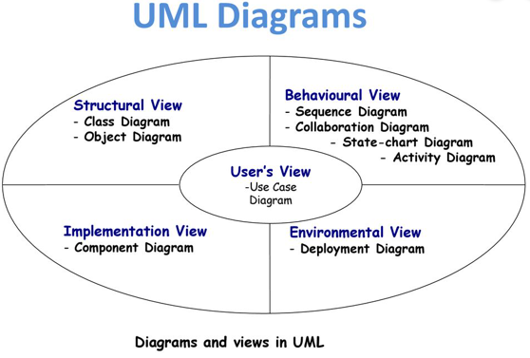
Source: slideplayer.com

Slide 8
UML Diagrams
Use case diagram
Activity diagram/Swimlane MST
Class diagram
Sequence diagram
Collaboration diagram
State diagram
Object diagram After MST
Component diagram
Deployment diagram

Slide 9
What is USE CASE diagram?
A use case diagram establish the capability of the system as a whole.
Components of use case diagram:
Actor
Use case
System boundary
Relationship
Actor relationship
Semantic of the components is followed.

Slide 10
ACTOR:
What is an actor?
An actor is some one or something that must interact with the system under development
UML notation for actor is stickman, shown below.
Customer
Manager
Cashier

Slide 11
ACTOR:
More about an actor:
It is role a user plays with respect to system.
Actors are not part of the system they represent anyone or anything that must interact with the system.
Actors carry out use cases and a single actor may perform more than one use cases.
Actors are determined by observing the direct uses of the system,

Slide 12
ACTOR:
Contd…
Those are responsible for its use and maintain as well as other systems that interact with the developed system.
An actor may
  - input information to the system.
  - receive information from the system.
  - input to and out from the system.

Slide 13
ACTOR:
How do we find the actor?
Ask following questions to find the actors:
  Who uses the system?
  Who installs the system?
  Who Starts up the system?
  What other systems use this system?
  Who gets the information from the system?
  Who provides information to the system?
Actor is always external to the system. They are never part of the
system to be developed.

Slide 14
ACTOR:
4-Categories of an actor:
Primary Actor : Who uses the main system functions.
Secondary Actor: Who takes care of administration & maintenance.
External h/w : The h/w devices which are part of application domain and must be used.
Other system: The other system with which the system must interact.

Slide 15
USE CASE:
What is USE case?
A use case is a pattern of behavior, the system exhibits
Each use case is a sequence of related transactions performed by an actor and the system in dialogue.
USE CASE is dialogue between an actor and the system.
Examples:
Open new account
Withdrawal of cash
from ATM

Slide 16
SYSTEM BOUNDARY:
What is System Boundary?
It is shown as a rectangle.
It helps to identify what is external verses internal, and what the
responsibilities of the system are.
The external environment is represented only by actors.

Slide 17
RELATIONSHIP between Use Cases
Relationship between two use cases is refereed as either include or extends.
<<includes>> Arrow is towards secondary use case
Multiple use cases share a piece of same functionality.
This functionality is placed in a separate use case rather than
documenting in every use case that needs it.
<<includes>> relationship shows behavior that is common to one or more use cases

Slide 18
RELATIONSHIP between Use Cases
<<extends>> Arrow is towards primary use case
It is used to show optional behavior, which is required only
under certain condition.
e.g. Order and Rush Order: Rush Order is a special/optional case of order.
Here Order is a normal order which is served within 30 minutes and user can select Rush Order instead, which means meal will be served within 10 minutes and user will have to pay Rs. 100 extra.

Slide 19
Generalisation
Actors and use cases can be generalised, showing that one is simply a special case of the other
  This is like inheritance in object-oriented design
  Suppose that to borrow a CD, users must have additional registration and pay per CD.
borrow book
Borrower : books only
borrower
borrow CD
Borrower : books and CDs

Slide 20
USE CASE Diagram for Withdraw Cash
Balance status
report
<<extends>>
Withdraw cash
Clerk
Customer
<<includes>>
Validation
ATM DB
Manager

Slide 21
USE CASE Template Contd.
Typical Course of Events/ Successful Scenario/ Normal Scenario
ACTOR ACTION(AA) : Numbered actions of the actor.
SYSTEM RESPONSE(SR): Numbered description of system responses.
SYSTEM ACTION(SA): Numbered description of system responses.
Exceptional Flow of Events/ Extension points
Alternate Flow
Post Condition( if any)

Slide 22
Typical Course of Events/ Successful Scenario/ Normal Scenario
( To be written in related Use Case Template )
For withdrawal of cash:
1.(SR) The ATM asks the user to insert a card.
2.(AA) The user inserts a cash card.
3.(SR) The ATM accepts the card and reads its serial number.
4.(SR) The ATM requests the password.
5.(AA) The user enters 1234.
6.(SR) The ATM verifies the serial number and password with the
bank and gets the notification accordingly.
7.(SA)The ATM asks the user to select the kind of transaction.
8.(AA)User selects the withdrawal.

Slide 23
Normal Flow of Events:
9.(SR)The ATM asks for the amount of cash; user enters Rs. 2500/-
10.(SR)The ATM verifies that the amount of cash is within predefined policy limits and asks the bank, to process the transaction which eventually confirms success and returns the new account balance.
11.(SR) The ATM dispenses cash and asks the user to take it.
12.(AA) The user takes the cash.
13.(SR) The ATM asks whether the user wants to continue.
14.(AA) The user indicates no.
15.(SR) The ATM prints a receipt, ejects the card and asks the user to take them
16.(AA) The user takes the receipt and the card.
17.(SR) The ATM asks a user to insert a card.

Slide 24
Alternative Flow of Events:
For withdrawal of cash use case:
9. The ATM asks for the amount of cash; the user has change of mind and hits the “cancel”.

Slide 25
Exceptional Flow of Events:
For withdrawal of cash use case:
3 Suspicious pattern of usage on the card.
10 The machine is out of cash.
11 Money gets stuck in the machine.

Slide 26
USE CASE Template
Generic format for documenting the use case:
- Pre condition: If any
  Use case: Name of the case.
  Actors : List of actors(external agents), indicating who initiates the use case.
  Purpose : Intention of the use case.
  Overview : Description.
  Type : primary / secondary.
  Post condition : State after the scenario is complete

Slide 27
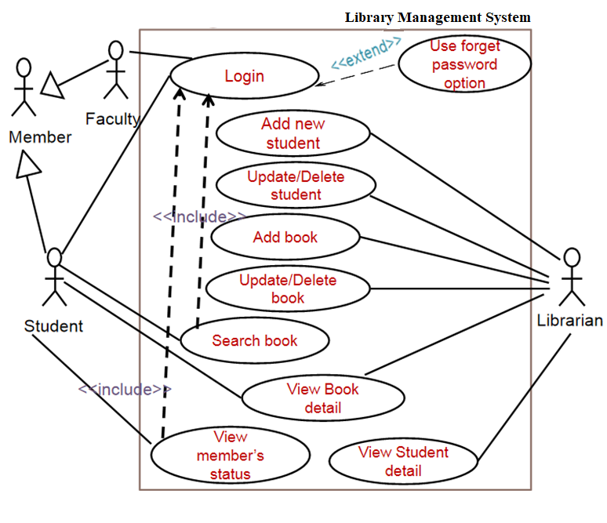
Another Example – Library Management System
Pls Note: Use <<extends>> instead of <<extend>> and
<<includes>> instead of <<include>>

Slide 28
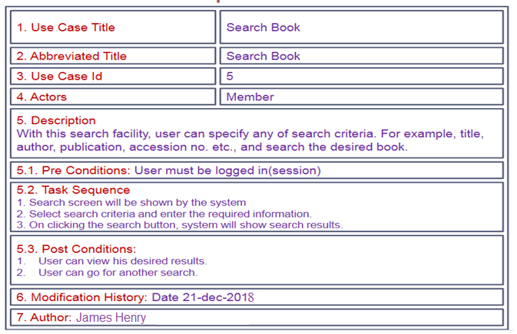
Sample Use Case Template– Library Management System

Slide 29
Activity diagrams
Activity diagrams are
  a technique to describe procedural logic, business process & work flow
  similar to flowcharts, but the latter does not support parallel behaviour
  used to model a specific use case at a more detailed level
States
  have transitions to other states
  may be either
    action states: atomic action
    activity states: actions that can be broken down
  may have decisions, explained by conditions & merges
  may have forks & joins for modelling simultaneous activities

Slide 30


Activity diagram notation
Action/Activity
  Long rounded rectangle
Start/Initial State
  unique with only one transition line
End State
  not necessarily unique
Transition
  Lines indicate sequential flow of actions.
  Must be labeled after a decision.
  Arrows indicate direction of next action
Activity is shown in more detail in another diagram
Condition

Slide 31
Decision Points & Guards
NOTE: Please stick to notation of activity
While drawing
diagrams
Decision point : diamond
  Single entry transition line
  Multiple exit transition lines
    each with Guard (condition)
    exit lines must cover all eventualities
There could be a problem with the
decisions in this diagram.
What do you think it is?
[sunny]
[rainy]
socks
sandals
shoes

Slide 32
Merge Points
Merge : diamond
  Are used to indicate a merge after a decision
  Multiple entry, single exit
  In UML1, more than one transition line canenter an activity.
  In UML2 (and in this module), use merge
  diamonds.
[sunny]
[rainy]
socks
sandals
shoes
shoes
sandals
go out
go out
UML1

Slide 33
Synchronisation
Sometimes certain action sequences can be done in parallel (synchronously, concurrently, simultaneously)
Fork
  Shows start of concurrent actions
  The thread within each exit can be executed at the same time as the other thread
  Single entry, multiple exits
Join
  Shows end of concurrent actions
  The exit cannot occur until all entry threads have been completed
  Multiple entry, single exit

Slide 34
Example: Online Shopping
Fill in form
Process order
  -The fork shows that the collection slip can be printed at the same time as the items are being picked out and sent for collection.
  -The join shows that you can’t collect them until the slip has been printed and also the items have been picked out and sent for collection.
[order cancelled]
[order ok]
process
payment
Items picked
Collection
slip printed
Sent for collection
Collect items

Slide 35
Swimlanes / partitions
Useful to model activity's procedural flow of control between objects
Use vertical columns
Place object’s name at the top of the column
Place each action associated with an object in that object's swimlane

Slide 36
Example: Online Shopping
Member
Till staff
Warehouse staff
Fill in form
Process order
[Order cancelled]
[order ok]
Process
payment
Items picked
Collection
slip printed
Sent for collection
Collect
items

Slide 37
Example: Shopping in Argos
Process order
Item entered
into computer
[not in
stock]
Remove item
[in stock]
[all items processsed]
[more items]

Slide 38
Another Example of an Activity Diagram
Academic Section
Accounts Section
Hostel Office
Hospital
Department
check
student
records
receive
fees
allot
hostel
create
hospital
record
receive
fees
register
in
course
conduct
medical
examination
allot
room
issue
identity card
Activity diagram for student admission procedure

